Slide 1
Agent based models of debt and collapse

Slide 2
Why econophysics?
Or: Are physicist the most arrogant scientists?
Presumptuous I can do better than economists?
… So, what are the economists doing?
Notes:
Don’t read all the quotes out, just mention things like:

Slide 3
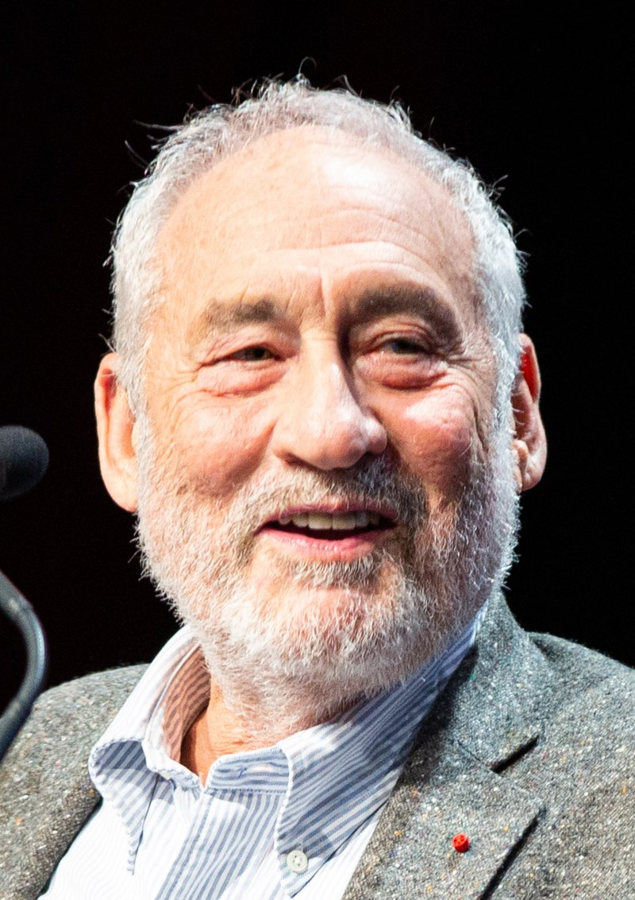
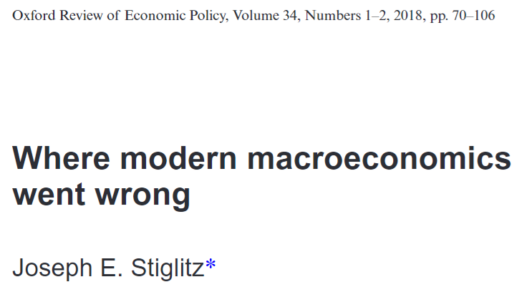
Why econophysics?
Or: Are physicist the most arrogant scientists?
… So, what are the economists doing?
J. E. Stiglitz
Photo by Jérémy Barande
All quotes and equations from [Stiglitz18].
Notes:
Don’t read all the quotes out, just mention things like:

Slide 4
Why econophysics?
Or: Are physicist the most arrogant scientists?
In short: Critiques complexity of existing models
“What we seek from a ‘benchmark model’ in macroeconomics is not always clear. [He] suggests that we should be looking ‘for a simple model which we could teach to graduate students to provide them with a less misleading framework […]” (Bold by me)
J. E. Stiglitz
Photo by Jérémy Barande
“The models should capture what we believe are the macro-essential characteristics of the behavior of firms and people, and not try to capture all relevant dynamics. Only then can they serve their purpose, remain simple enough, and provide a platform for theoretical discussions.” (Bold by me)
“And with so many parameters, macro-econometrics becomes little more than an exercise in curve fitting […]” (Bold by me)
All quotes and equations from [Stiglitz18].
Notes:
Don’t read all the quotes out, just mention things like:

Slide 5

Why econophysics?
Or: Are physicist the most arrogant scientists?
J. E. Stiglitz
Photo by Jérémy Barande
… I may be presumptuous, but at least I don’t have >15 parameters
All quotes and equations from [Stiglitz18].
Notes:
Don’t read all the quotes out, just mention things like:

Slide 6
Fisher’s debt-deflation cycle
Shock
Debt Liquidation
Disturbed interest rates
Distress Selling
Hoarding, slower circulation
Loans paid off (lower money supply)
Pessimism
Deflation (fall in prices)
Fall in business output
Fall in business worth
Notes:
Original. Simplified. My interpretation/implementation.

Slide 7
Fisher’s debt-deflation cycle
Shock
Debt Liquidation
Disturbed interest rates
Decrease in money
Hoarding, slower circulation
Pessimism
Deflation (fall in prices)
Fall in business output
Fall in business worth
Notes:
Original. Simplified. My interpretation/implementation.

Slide 8

What is a company?
× N
Production capacity p
(Employees, equipment etc.)
Debt d
(Negative d = money)
Confidence β
Notes:
N companies, each with two variables p and d and a parameter beta

Slide 9
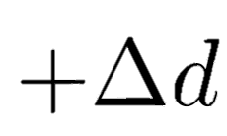
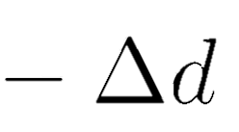


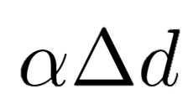
How do companies interact?
Transfer money
Increase production
Transactions convert debt to production capacity
Notes:
Jysk needs some new computers, so they give money (increases debt) to IBM, and in return gains increased production capacity

Slide 10
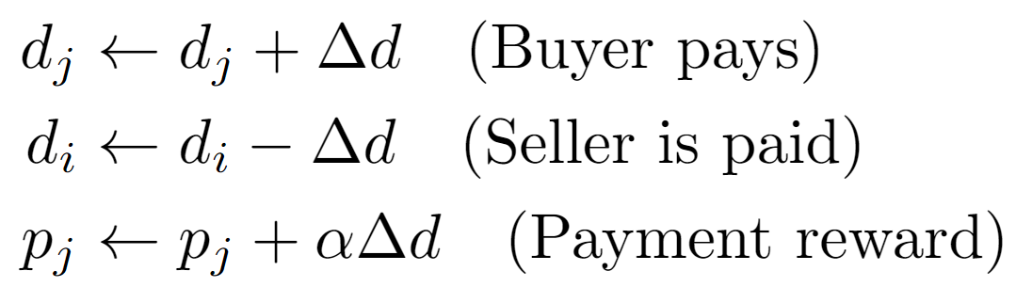
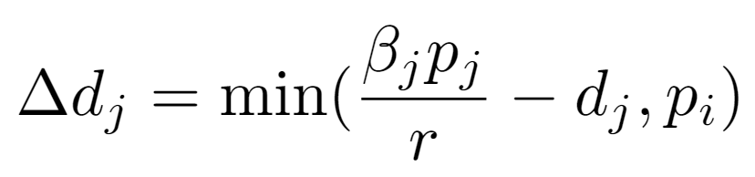
How do companies interact?
Transfer money
Increase production
Can’t buy more than seller can produce
Prevent bankruptcy
Notes:
Company j buys from i. Takes loan if necessary. Converts spent money into production capacity

Slide 11
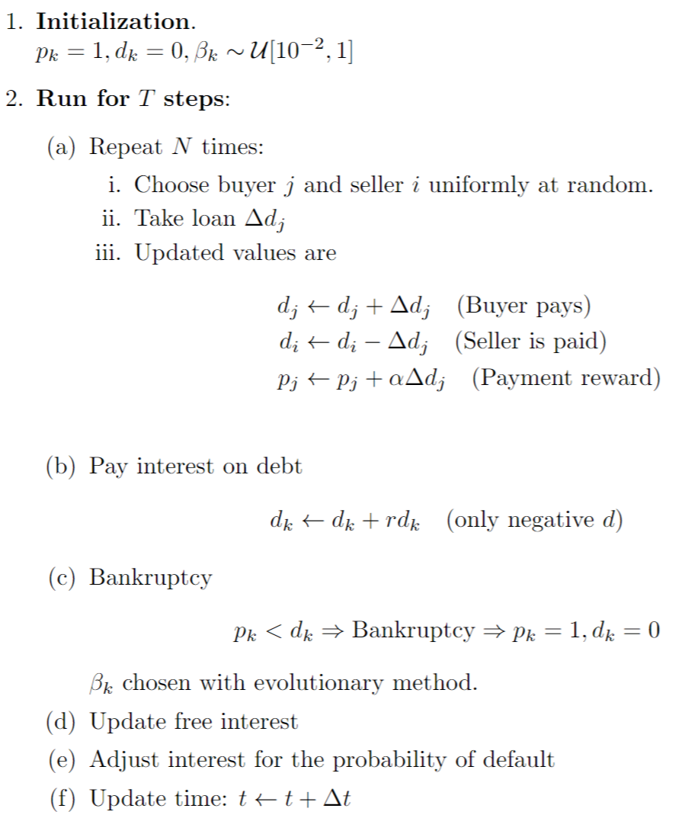
Transaction
Variable reminder
p: production capacity
d: debt
β: Confidence
α: d to p efficiency
r: interest rate

Slide 12
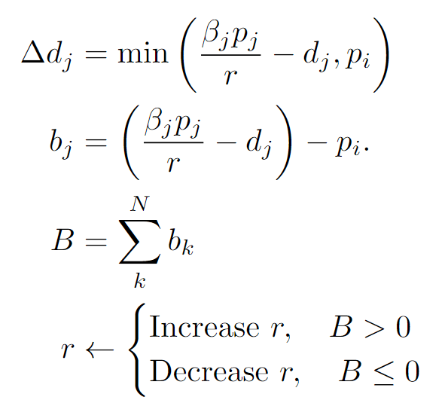
Interest update

Slide 13
Results
mean and interest rate
beta
Animation values

Slide 14
Insecurities
Bankruptcy criteria
Interest update

Slide 15
Difficulties
Too extreme boom-busts
Companies hate debt (beta small)
Greedy bank
Variable reminder
p: production capacity
d: debt
β: Confidence
α: d to p efficiency
r: interest rate

Slide 16
References
[Stiglitz18] Stiglitz, J. E. (2018). Where modern macroeconomics went wrong. Oxford Review of Economic Policy, 34(1-2), 70-106.

